Slide 1
COMPUTER ORGANIZATION
AND
ARCHITECTURE
SYLLABUS and SCHEME

Slide 2
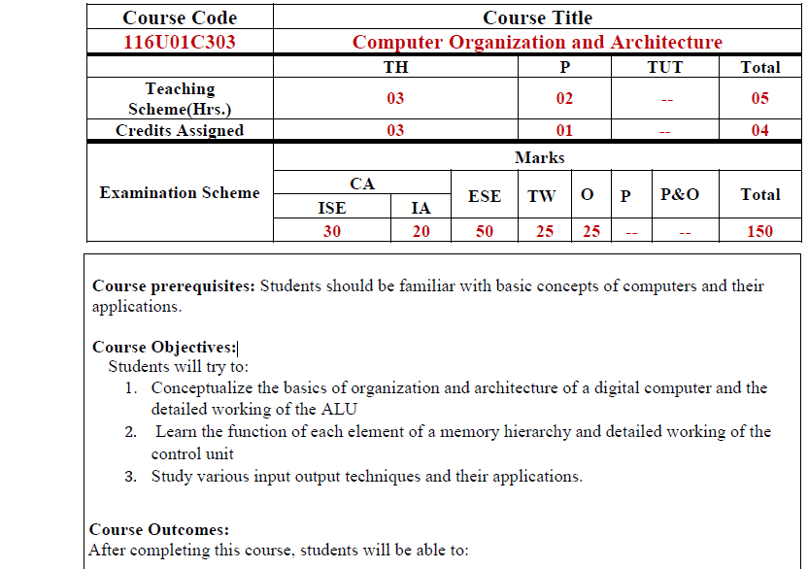

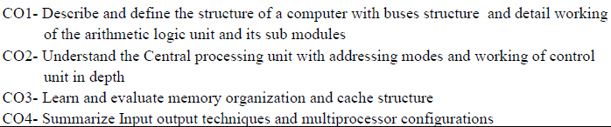

Slide 3
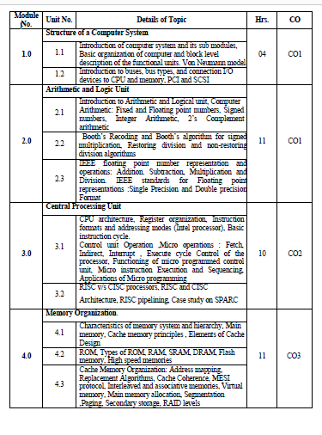
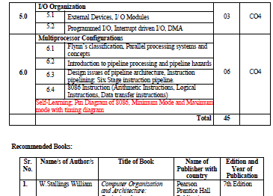

Slide 4
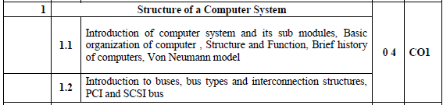
Module 1

Slide 5
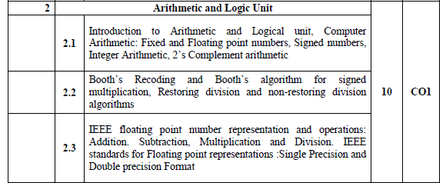
Module 2

Slide 6
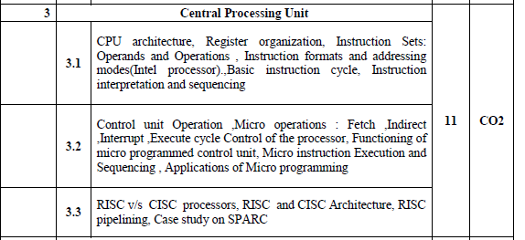
Module 3

Slide 7
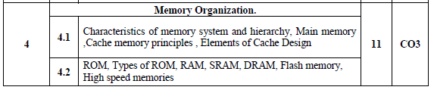
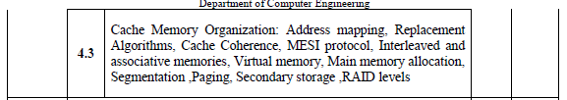
Module 4

Slide 8
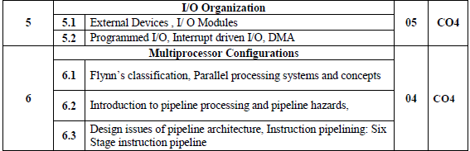
Module 5 & 6

Slide 9
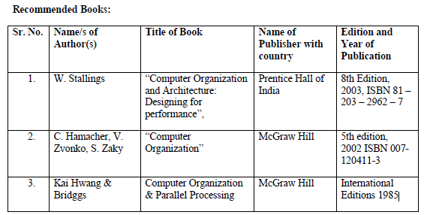
COA-William Stallings

Slide 10
William Stallings
Computer Organization and Architecture
Chapter 1
Introduction

Slide 11
Architecture & Organization
Architecture is those attributes visible to the programmer
  Instruction set, number of bits used for data representation, I/O mechanisms, addressing techniques.
Organization is how features are implemented
  Control signals, interfaces, memory technology.
  e.g. Is there a hardware multiply unit or is it done by repeated addition?

Slide 12
COMPUTER ARCHITECTURE | COMPUTER ORGANIZATION
Way hardware components are connected together to form a computer system. | Structure and behaviour of a computer system as seen by the user.
It acts as the interface between hardware and software. | It deals with the components of a connection in a system.
Helps us to understand the functionalities of a system. | How exactly all the units in the system are arranged and interconnected.
A programmer can view architecture in terms of instructions, addressing modes and registers. | Whereas Organization expresses the realization of architecture.
While designing a computer system architecture is considered first. | An organization is done on the basis of architecture.
Computer Architecture deals with high-level design issues. | Computer Organization deals with low-level design issues.
Architecture involves Logic (Instruction sets, Addressing modes, Data types, Cache optimization) | Organization involves Physical Components (Circuit design, Adders, Signals, Peripherals)

Slide 13
Architecture & Organization
All Intel x86 family share the same basic architecture
The IBM System/370 family share the same basic architecture
This gives code compatibility
  At least backwards
Organization differs between different versions

Slide 14
S.NO | Processor | Clock Speed | Bus Width | MIPS | Power | Price
1 | Intel Pentium 111 | The clock speed of Intel Pentium 111 processor is 1GHz | The bus width of Intel Pentium 111 processor is 32 | A million instructions per second of Intel Pentium 111 processor is ~900 | The power of this processor is 97 W | $900
2 | IBM PowerPC 750X | The clock speed of the IBM PowerPC 750X processor is 550 MHz | The bus width of the IBM PowerPC 750X processor is 32/64 | A million instructions per second of IBM PowerPC 750X processor is ~1300 | The power of this processor is 5 W | #900
3 | MIPS R5000 | The clock speed of the MIPS R5000 processor is 250 MHz | The bus width of the MIPS R5000 processor is 32/64 | NA | NA | NA
4 | StrongARM SA-110 | The clock speed of StrongARM SA-110 processor is 233 MHz | The bus width of StrongARM SA-110processor is 32 | The million instructions per second of StrongARM SA-110processor is 268 | The power of this processor is 1 W | NA

Slide 15
Structure & Function
Structure is the way in which components relate to each other
Function is the operation of individual components as part of the structure

Slide 16
Function
All computer functions are:
  Data processing
  Data storage
  Data movement
  Control

Slide 17

Functional View

Slide 18

Operations (a) Data movement

Slide 19
Operations (b) Storage

Slide 20
Operation (c) Processing from/to storage

Slide 21
Operation (d)
Processing from storage to I/O

Slide 22
Structure - Top Level
Peripherals
Computer
Central
Processing
Unit
Main
Memory
Computer
Systems
Interconnection
Input
Output
Communication
lines

Slide 23
Structure - The CPU
CPU
Computer
Arithmetic
and
Logic Unit
I/O
Registers
System
Bus
CPU
Internal CPU
Interconnection
Memory
Control
Unit

Slide 24
Structure - The Control Unit
Control Unit
CPU
ALU
Sequencing
Logic
Internal
Bus
Control
Unit
Control Unit
Registers and
Decoders
Registers
Control
Memory

Slide 25
William Stallings
Computer Organization and Architecture
8th Edition
Chapter 2
Computer Evolution and Performance

Slide 26
Von Neumann
Stored Program concept
Main memory storing programs and data
ALU operating on binary data
Control unit interpreting instructions from memory and executing
Input and output equipment operated by control unit
Princeton Institute for Advanced Studies
  IAS
Completed 1952

Slide 27

Structure of Von Neumann machine

Slide 28

Structure of IAS – detail

Slide 29
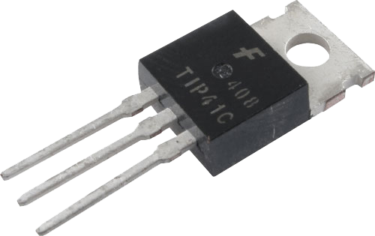
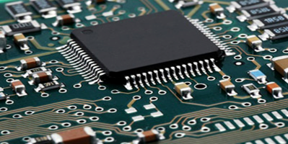
Generations of Computer
Vacuum tube - 1946-1957
Transistor - 1958-1964
Small scale integration - 1965
  Up to 100 devices on a chip
Medium scale integration - to 1971
  100-3,000 devices on a chip
Large scale integration - 1971-1977
  3,000 - 100,000 devices on a chip
Very large scale integration - 1978 -1991
  100,000 - 100,000,000 devices on a chip
Ultra large scale integration – 1991 -Over 100,000,000 devices on a chip

Slide 30
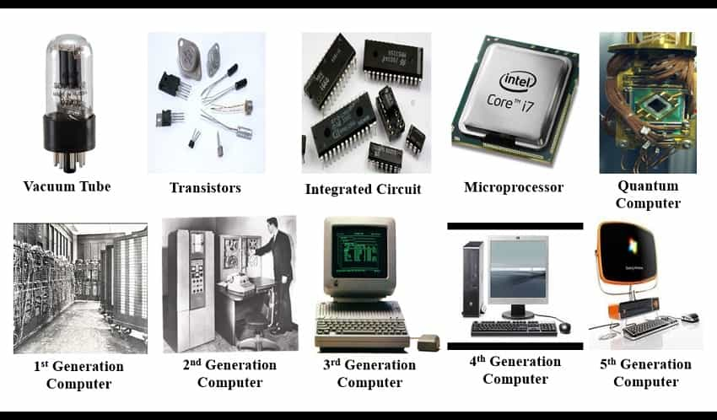

Slide 31
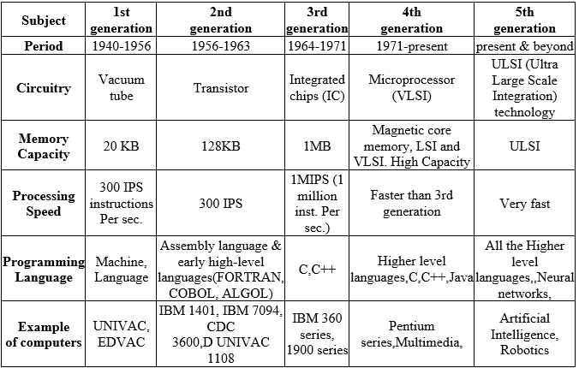

Slide 32
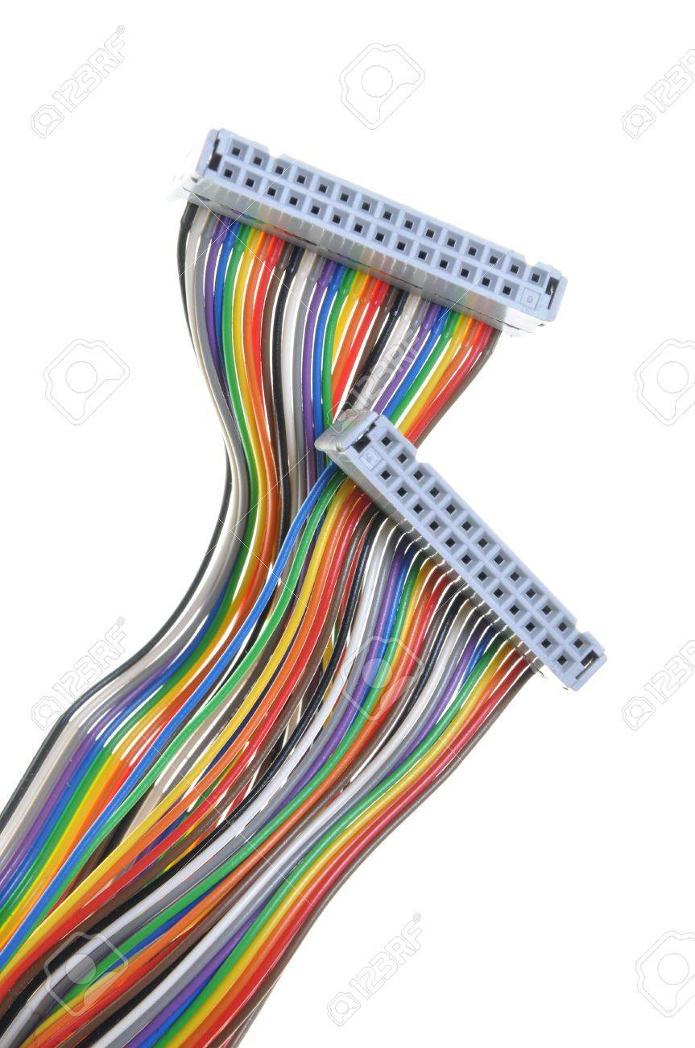
What is a Bus?
A communication pathway connecting two or more devices
Data connection between 2 or more devices connected to the computer
Usually broadcast ,Often grouped
  For Ex: A bus enables a computer processor to communicate with the memory or video card to communicate with the memory
  e.g. 32 bit data bus is 32 separate single bit channels
Power lines may not be shown

Slide 33
BUS
A computer is full of buses
    highways that take information and power from on­e place to another.
This pathway is used for communication purpose and it is established between two or more computer components.
  Having a high-speed bus is as important as having a good transmission in a car.
    Ex: - If you have a 700-horsepower engine combined with a cheap transmission, you can't get all that power to the road.

Slide 34
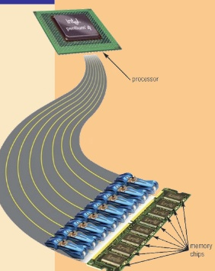
Buses
There are a number of possible interconnection systems
Single and multiple BUS structures are most common
e.g. Control/Address/Data bus (PC)
e.g. Unibus (DEC-PDP)
(Digital Equipment Corporation-Programmed Data Processor)

Slide 35
Functions of Buses in Computers
Data sharing - Serial/Parallel, 8-bit, 16-bit, 32-bit or even 64-bit buses.
Addressing - A bus has address lines which allows data to be sent to or from specific memory locations.
Power - A bus supplies power to various peripherals connected to it.
Timing - System clock-synchronize the peripherals attached to it with the rest of the system.
Eg: The expansion bus facilitates easy connection of more or additional components and devices on a computer such as a TV card or sound card.

Slide 36
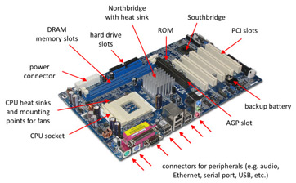
Notes:
Northbridge&Southbridge-The northbridge links the CPU to very high-speed devices, especially RAM and graphics controllers, and the southbridge connects to lower-speed peripheral buses (such as PCI or ISA)
AGP-Accelerated Graphics

Slide 37
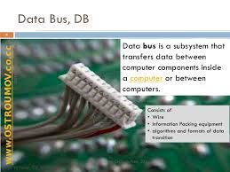
Data Bus
Carries data
  Remember that there is no difference between “data” and “instruction” at this level
Width is a key determinant of performance
  8, 16, 32, 64 bit

Slide 38
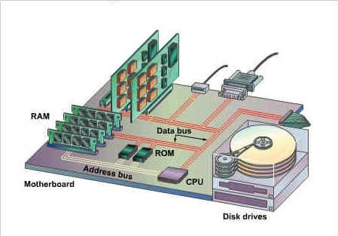
Address bus
Identify the source or destination of data-Eg 1000H,1200H
e.g. CPU needs to read an instruction (data) from a given location in memory
Bus width determines maximum memory capacity of system
2 ^nos of address lines=Memory Capacity
  e.g. 8080 has 16 bit address bus giving 64k address space
  32 bit?64bit ? 2 ^
  (16.777216 million terabyte)

Slide 39
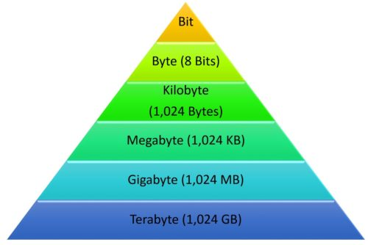
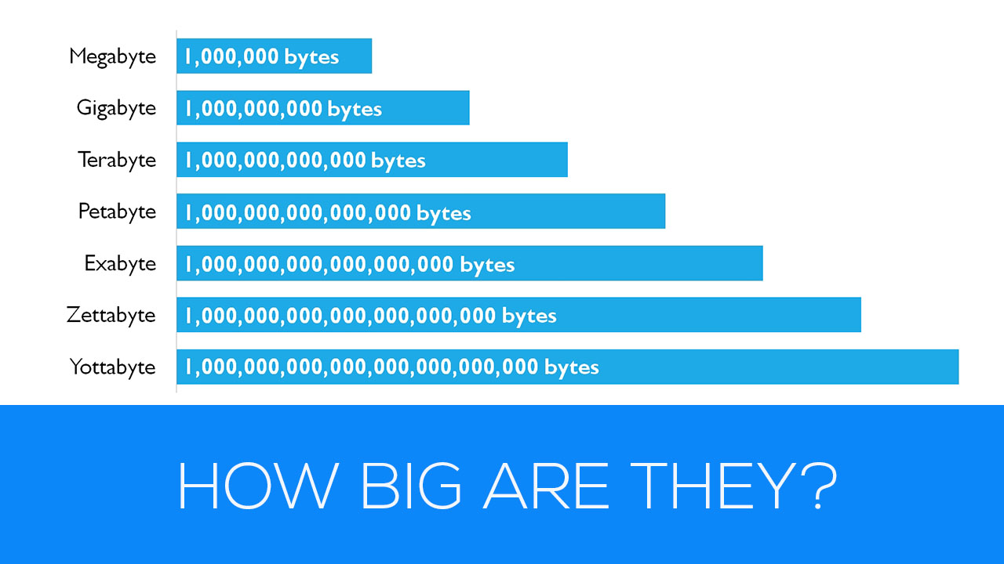

Slide 40
Control Bus
Controls activities of all units of a computer
Main Function is to carry control signals generated by control unit
  Ex: One line of control bus is used to indicate whether the CPU is reading/writing to the main memory
Control and timing information
  Memory read/write signal
  Interrupt request
  Clock signals

Slide 41

Bus Interconnection Scheme
System

Slide 42
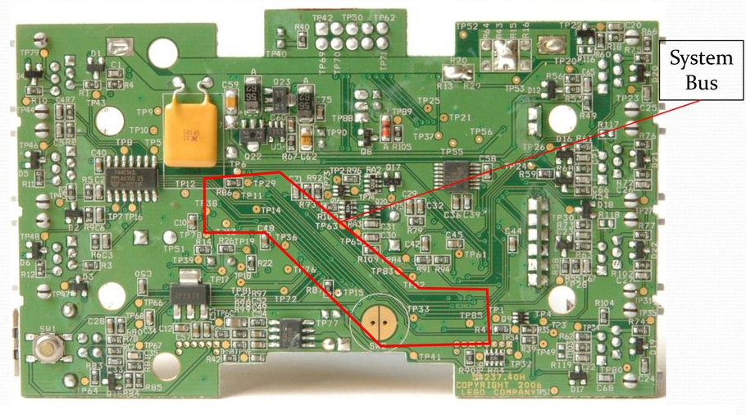

Slide 43
Single Bus Problems
Lots of devices on one bus leads to:
  Propagation delays
    Long data paths mean that co-ordination of bus use can adversely affect performance
    If aggregate data transfer approaches bus capacity
Most systems use multiple buses to overcome these problems

Slide 44
Bus Types
Dedicated
  Separate data & address lines
Multiplexed
  Shared lines
  Address valid or data valid control line
  Advantage - fewer lines
  Disadvantages
    More complex control
    Ultimate performance

Slide 45
Bus Arbitration
More than one module controlling the bus
e.g. CPU and DMA controller
Only one module may control bus at one time
Arbitration may be centralised or distributed

Slide 46
Centralised or Distributed Arbitration
Centralised
  Single hardware device controlling bus access
    Bus Controller
    Arbiter
  May be part of CPU or separate
Distributed
  Each module may claim the bus
  Control logic on all modules

Slide 47
Introduction to PCI Bus
Bus
  highways that take information and power from on­e place to another.
  channel or path between the components in a computer
  lets you connect components to the computer's processor
  hard disks, memory, sound systems, video systems , graphics card etc…
PCI Bus
Nowadays USB-
Used as the standard in most computers' high-speed buses
Firewire ?
ISA Bus- Industry Standard Architecture
IT PROVIDES DIRECT ACCESS TO SYSTEM MEMORY FOR CONNECTED DEVICES
Intel created the PnP standard and incorporated it into the design for PCI.

Slide 48
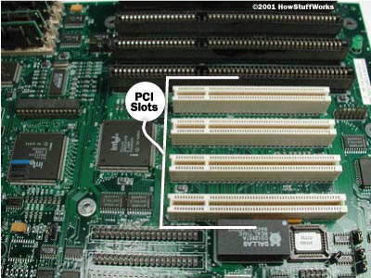
PCI Bus-Peripheral Component Interconnect
Intel released to public domain-32 bit and 64 bit versions
PCI bus connects the CPU and expansion boards
  Examples of PCI devices
    Modem
    Network Card
    Sound Card,Video Card,etc

Slide 49
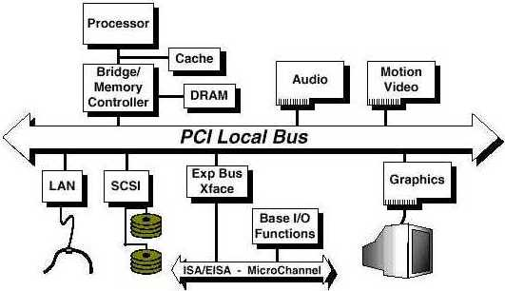
PCI Bus Lines (required)
Systems lines
  Including clock and reset
Address & Data
  32 time mux lines for address/data
  Interrupt & validate lines
Interface Control
Arbitration
  Not shared
  Direct connection to PCI
  bus arbiter
Error lines

Slide 50
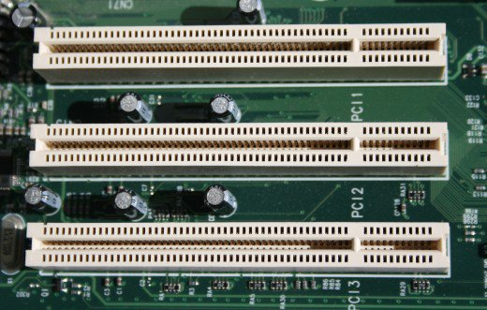
PCI Bus Lines (Optional)
Interrupt lines
  Not shared
Cache support
64-bit Bus Extension
  Additional 32 lines
  Time multiplexed
  2 lines to enable devices to agree to use 64-bit transfer

Slide 51
Let's say that you have just added a new PCI-based sound card to your Windows XP computer. Here's an example of how it would work.
You open up your computer's case and plug the sound card into an empty PCI slot on the motherboard
You close the computer's case and power up the computer.
The system BIOS initiates the PnP BIOS.
The PnP BIOS scans the PCI bus for hardware. It does this by sending out a signal to any device connected to the bus, asking the device who it is.
The sound card responds by identifying itself. The device ID is sent back across the bus to the BIOS.
The PnP BIOS checks the ESCD to see if the configuration data for the sound card is already present. Since the sound card was just installed, there is no existing ESCD record for it.
The PnP BIOS assigns IRQ, DMA, memory address and I/O settings to the sound card and saves the data in the ESCD.
Windows XP boots up. It checks the ESCD and the PCI bus. The operating system detects that the sound card is a new device and displays a small window telling you that Windows has found new hardware and is determining what it is.
In many cases, Windows XP will identify the device, find and load the necessary drivers, and you'll be ready to go. If not, the "Found New Hardware Wizard" will open up. This will direct you to install drivers off of the disc that came with the sound card.
Once the driver is installed, the device should be ready for use. Some devices may require that you restart the computer before you can use them. In our example, the sound card is immediately ready for use.
You want to capture some audio from an external tape deck that you have plugged into the sound card. You set up the recording software that came with the sound card and begin to record.
The audio comes into the sound card via an external audio connector. The sound card converts the analog signal to a digital signal.
The digital audio data from the sound card is carried across the PCI bus to the bus controller. The controller determines which device on the PCI device has priority to send data to the CPU. It also checks to see if data is going directly to the CPU or to system memory.
Since the sound card is in record mode, the bus controller assigns a high priority to the data coming from it and sends the sound card's data over the bus bridge to the system bus.
The system bus saves the data in system memory. Once the recording is complete, you can decide whether the data from the sound card is saved to a hard drive or retained in memory for additional processing.

Slide 52
Introduction to SCSI Bus
Pronounced "scuzzy"
Fast bus that can connect lots of devices to a COMPUTER at the same time, including hard drives, scanners, CD-ROM/RW drives, printers and tape drives unlike USB connected for small devices.
Helps to put multiple items on one bus.
Also works with most computer systems.
Prob---
  Limited BIOS support as it has to be configured for each computer
  No common SCSI software interface
  All different types of SCSI have different speeds,bus widths,connectors
  Which can be confusing !

Slide 53
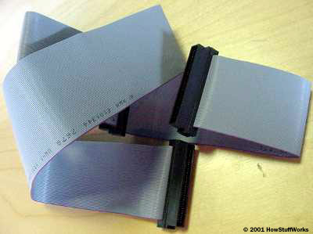
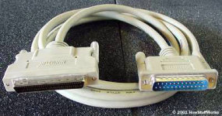
External SCSI devices connect using thick, round cables
Internal SCSI devices connect to a ribbon cable.

Slide 54
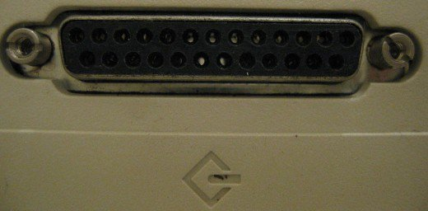
SCSI-Small Computer System Interface
Set of standard electronic interfaces that allow personal computers PC’s to communicate with peripheral hardware such as disk drives,tapes,CDs,Printers,scanners,etc
Faster.
SCSI standards are generally backward compatible
  A parallel interface standard used by Apple Macintosh computers, PCs and Unix systems for attaching peripheral devices to a computer.

Slide 55
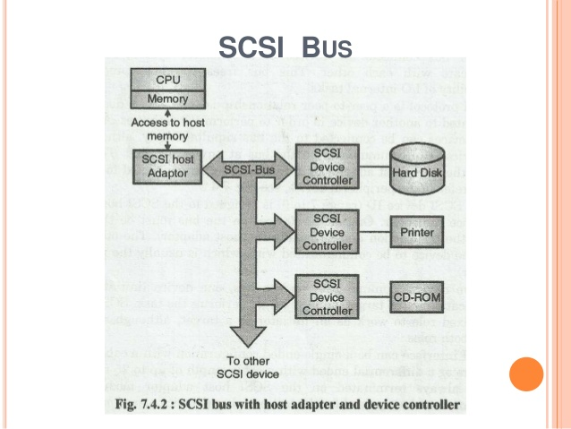

Slide 56
